Slide 2
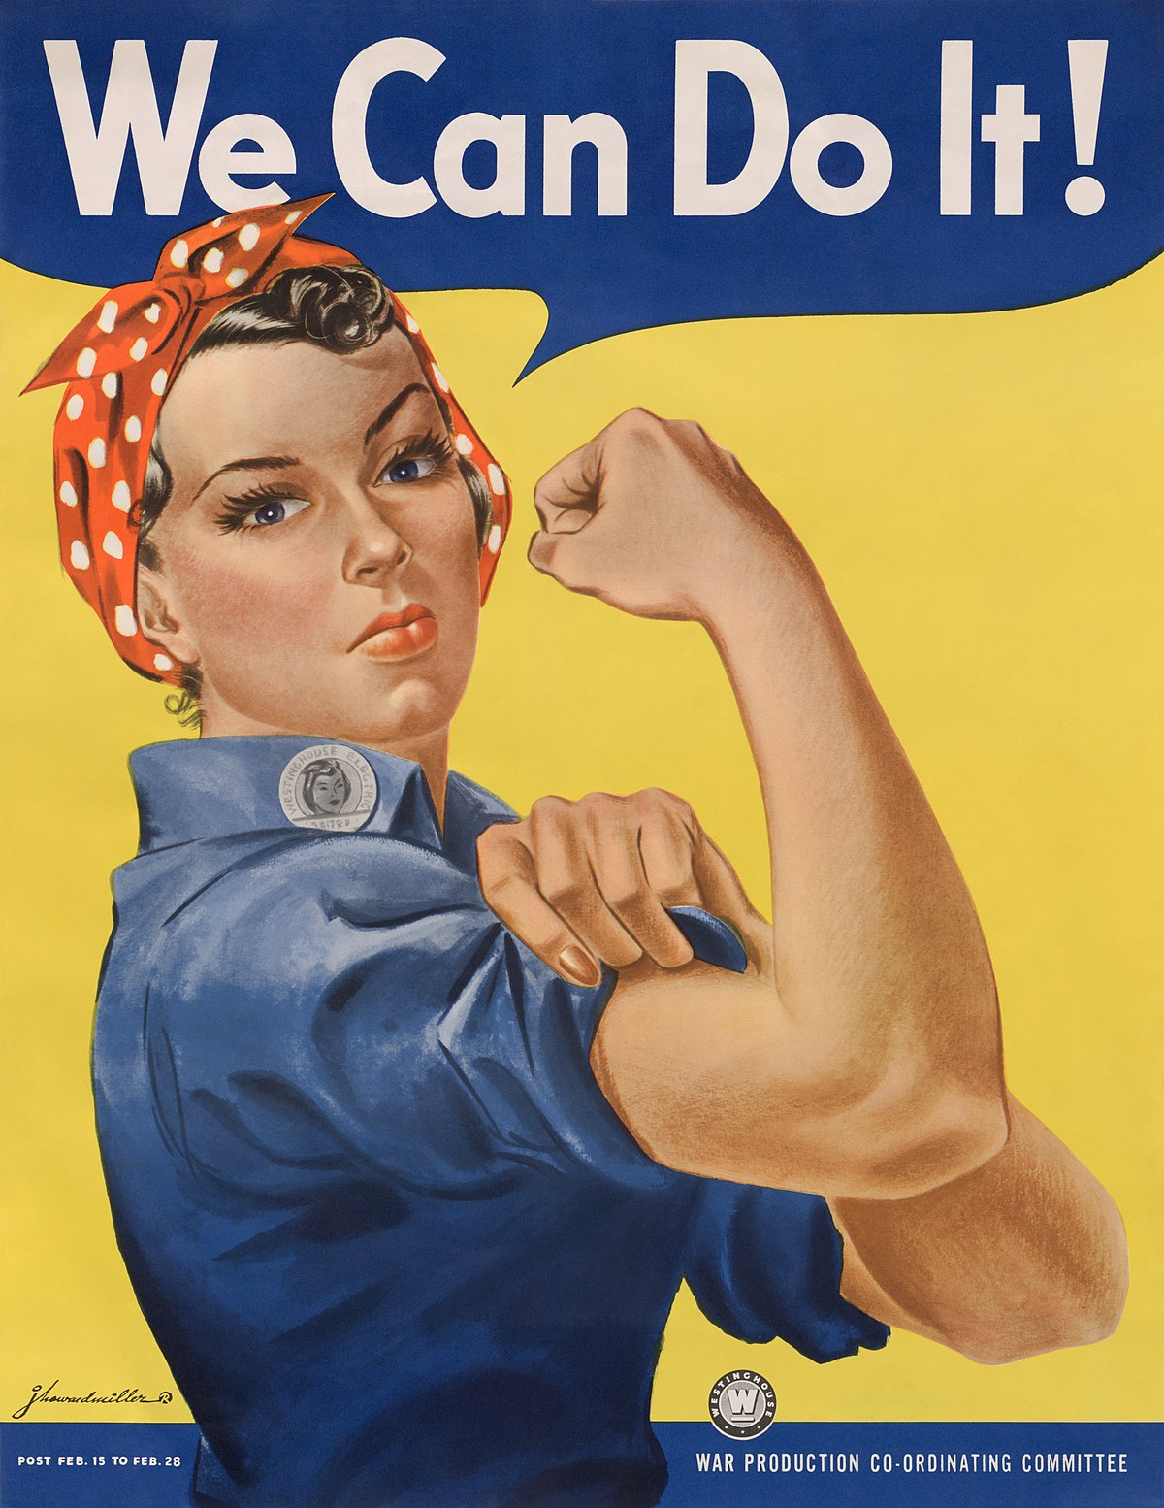
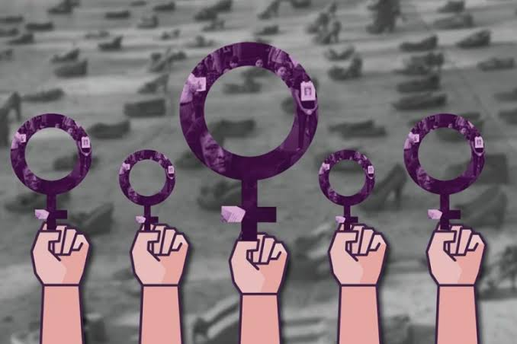
Stop!!!
Feminicides
Every time we are less , please respect us.
Emiliano Mtz.

